Slide 1
SIT216 User Centred Design
Topic 7
Evaluation

Slide 2
Last Topic...
Fundamental graphical design principles
Harmony, Balance and Simplicity
Refinement, Unity, Restraint and Modularity
Emotional design (affective usability) and some associated design considerations and implications.

Slide 3
This Topic
Analysing an interface for usability
Evaluation of interfaces
Concerns
Heuristic Evaluation
Alternative evaluation methods

Slide 4
Readings
Readings (in addition to the textbook):
http://www.nngroup.com/articles/how-to-conduct-a-heuristic-evaluation/
http://www.sitepoint.com/heuristic-evaluation-guide/
http://www.cs.uregina.ca/Links/class-info/305/lab2/example-he.html

Slide 5
Evaluation
1

Slide 6
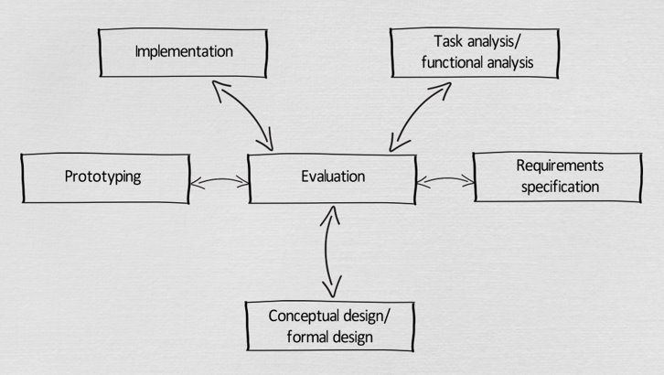
Objectives
To assess:
functionality of the product
effect of the interface on the user
identification of problems

Slide 7
Evaluation
Evaluation gathers data about the usability of a design.
It helps to define what users want.
It identifies problems with the interface.
It compares the new system with an existing system.

Slide 8
Evaluation: Why Bother?
Understanding the real world.
Comparing different designs.
Obtaining metrics.
Conforming with a standard.
UCD research:
develop theories about UCD
develop sound engineering principles.

Slide 9
Evaluation: Why Bother?
Evaluation within the development lifecycle:
pre-design:
determine viability
initial design:
develop initial design ideas
iterative design:
does system match user requirements?
identify problems
user feedback

Slide 10
Evaluating Design
Cognitive walkthroughs
A description of the prototype
A set of representative tasks that users would want to perform
A list of the actions that users must perform to complete each task
An indication of who the users are and the kind of experience and knowledge that they bring

Slide 11

Evaluating Design
Cognitive walkthroughs
Source: https://youtu.be/CeWAbGU5cSw

Slide 12
Activity - Evaluating Design
After watching this video, respond to the following questions on cognitive walkthroughs:
How often were the tasks/processes checked throughout the various stages of using the ATM?
What types of questions were being asked by the designers?
How would this data/feedback be used?

Slide 13
Evaluating Design
Heuristic evaluation
Several experts critique the design looking for potential problems
Used in the early design stages
Review-based evaluation
Compare this design to reviews of similar designs
Predictive evaluation
Past experiences, insights and data guiding (predicting) the evaluation

Slide 14
Interface Evaluation
Characterised by studying the interface:
Visibility and Affordance
Principles of HCI
Learnability
Flexibility
Efficiency
Robustness
Predictability
Memorability

Slide 15
Interface Evaluation
Evaluation can/should be applied across many different fields with a UCD focus:
Checking and refining the interface and interaction design decisions by understanding the target humans/users.
Some other fields include:
VR applications/experiences
Human-robots
Gaming

Slide 16
Interface & Interaction Evaluation
VR applications/experiences:
Source: https://youtu.be/6cKauhqzPiY

Slide 17
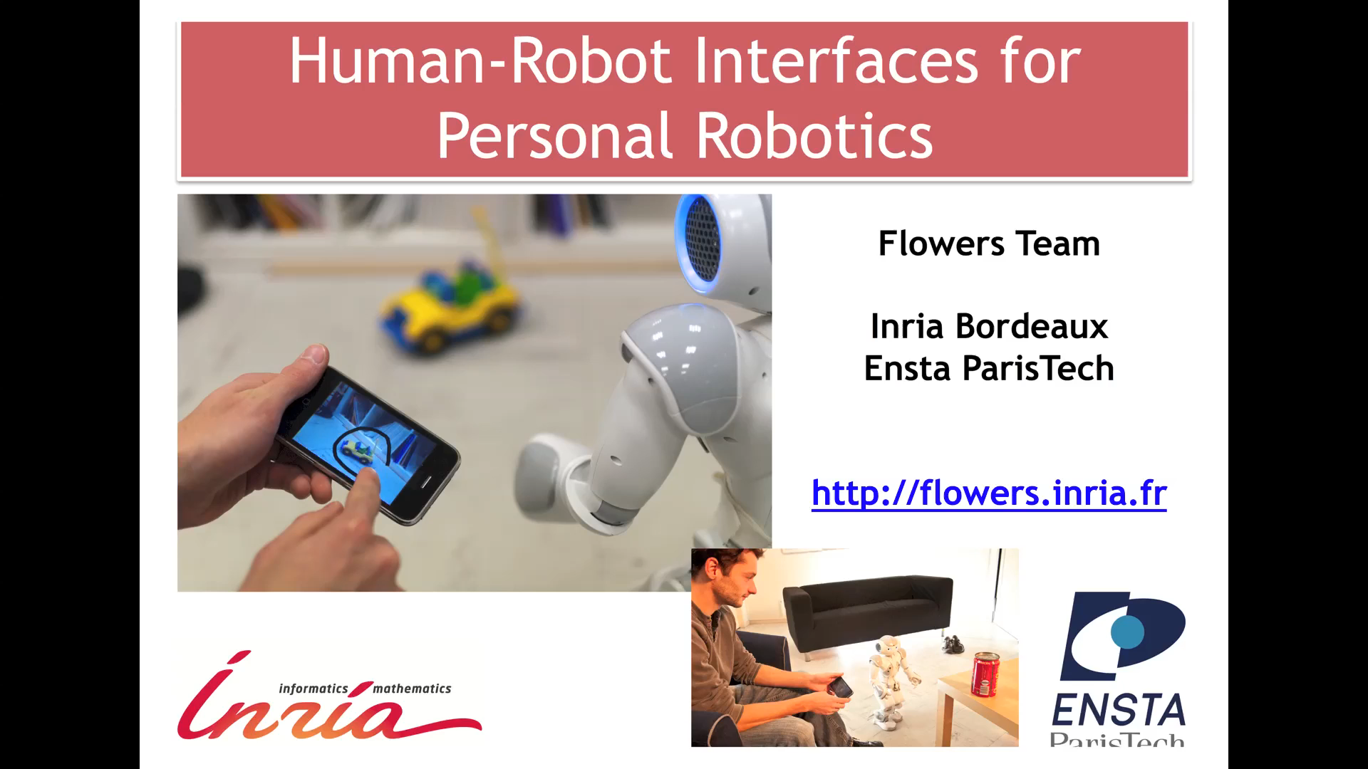
Evaluating Implementation
Robot evaluation example
Source: https://youtu.be/Qpn591m6hzU

Slide 18
Interface & Interaction Evaluation
Gaming:
Source: https://youtu.be/4DE_4HUX94E

Slide 19
Activity - Interface & Interaction Evaluation
After watching these videos on evaluation, think about and discuss with the students around you an example/s of a product/system/device that you have found difficult to use (one that suggests has not been evaluated well).
You can refer to a VR, robotics or gaming example, or another area/domain (except for websites and mobile apps)
Are the issues actually related to your inexperience (learnability) or lack of understanding (domain knowledge) or can you now identify some usability design flaws in the interface/interaction?

Slide 20
APPROACHES TO IMPLEMENTATION & evaluation
2

Slide 21
Approaches to Implementation & Evaluation
Naturalistic overview
Based upon:
observing and monitoring
collecting users’ opinions
being ongoing as the project evolves
Involves:
observation in realistic settings
study of “real life”
Has external validity

Slide 22
Approaches to Implementation & Evaluation
Experimental overview
Based upon:
experiments and benchmarking
Involves:
Interpretive Evaluation / Contextual Inquiry
guided by users
context of the system
“psychological” study
observe the effect of one or more dependent variables
easy to replicate
has internal validity
trade-off
generality of application (naturalistic) vs. precision and control (experimental)

Slide 23
Ethical Implications
Testing can be distressing
pressure to perform
feelings of inadequacy
competition with others
treat subjects with respect.

Slide 24
Ethical Implications
Management
don’t waste user’s time
don’t cause harm (directly or indirectly)
make them comfortable
maintain privacy – including data collection and storage
inform the user.
Potential impact on:
Reputation
Trust

Slide 25
Ethical Implications
Conducting ethical user research involves:
Consent and permission
Ensuring users/participants are fully informed
If details need to be withheld, they should be provided as soon as practically possible
An awareness and understanding of how users may react
Following cultural norms
Honest representation of users/participants and the data collected from the studies
Accurate recording of data

Slide 26
Ethical Implications
Conducting ethical research involves:
Ensuring data has been deidentified/anonymised (if required) and securely stored
Maintaining confidentiality/anonymity if reporting on user data
Appropriate data retention and destruction
Example additional references:
https://www.interaction-design.org/literature/article/conducting-ethical-user-research
https://www.uxbooth.com/articles/ethics-ux-research/
https://youtu.be/LU4JBOoX3Ys

Slide 27
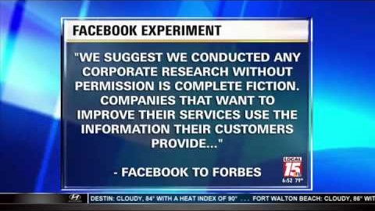
Activity – Ethical Implications
Facebook’s experiment from 2012:
Source: https://youtu.be/4DE_4HUX94E

Slide 28
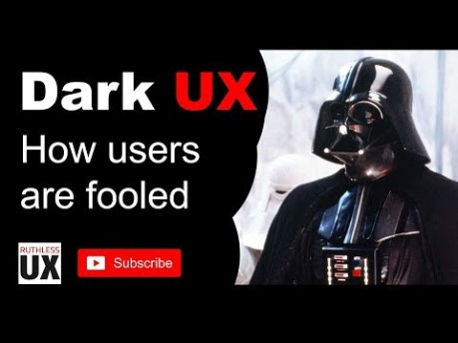
Activity – Ethical Implications
‘Dark UX’:
Source: https://youtu.be/4DE_4HUX94E
+ ‘Dark Patterns’ - https://youtu.be/kxkrdLI6e6M

Slide 29
Activity – Ethical Implications
Share your thoughts on Facebook’s actions regarding their 2012 experiment and on the tricks played on users (‘Dark UX’/‘Dark Patterns’)
Consider/discuss the impact on users

Slide 30
Focus on Users
Investigations into target humans/users:
Understand the user
WHO are they?
WHAT will they be doing?
HOW do they habitually complete the task?
HOW do they prefer to work?
WHAT are their skills, knowledge and motivation?
COLLABORATE with the user in determining the UI

Slide 31
Focus on the Task
Investigations into the tasks to be performed:
WHAT is the task? (task analysis - interview and observe)
WHAT is it intended to support? (results of task analysis)
WHAT expertise already exists?
COLLABORATE with the user (are we seeing a pattern here?????)

Slide 32
‘how to’ on NATURALISTIC EVALUATION
3

Slide 33
Naturalistic Evaluation
Observing Users
Direct Observation
Hawthorne Effect
Indirect Observation
Task-based Analysis
Performance-based Analysis
Post-task Walkthroughs
Verbal Protocols
Thinking Aloud

Slide 34
Naturalistic Evaluation
Software Logging
Automated data collection
Unobstrusive
Logging Tools
Time-stamped keypresses
Interaction logging
User Opinions
Structured Interviews
Flexible Interviews
Questionnaires & Surveys

Slide 35
Naturalistic Evaluation
Interpretative Evaluation
Contextual Inquiry
Usability studies in the workplace
“Ethnography”
Work, time, motivational, social
No metrics
Cooperative Evaluation
User thinks of themself as an evaluation collaborator rather than an evaluation subject.

Slide 36
Naturalistic Evaluation
Predictive Evaluation
Inspection Methods
Usage Simulations
Structured Expert Reviewing
Walkthroughs
Keystroke Modelling

Slide 37
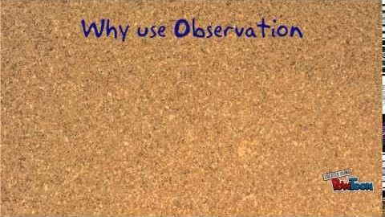
Activity - Naturalistic Evaluation
Using Observation:
Source: https://youtu.be/sDD7qS76Llo

Slide 38
Activity - Naturalistic Evaluation
Briefly recap 2-3 main points on the advantages or benefits of choosing an observational evaluation approach
Add a further 2-3 points on the disadvantages
How would you perform this ethically?

Slide 39
‘HOW TO’ ON EXPERIMENTAL EVALUATION
4

Slide 40
Experimental Evaluation
Experiments enable designers to manipulate variables and study their effects.
Traditional Experiments
Practical Issues
Usability Engineering
Problems?
Reliability & validity

Slide 41
Experimental Evaluation
Subjects
Match the expected user population
Age, gender, domain knowledge, IT knowledge,
Sample size: varies, but at least 10
Hypothesis
Dependent and independent variables
Statistical measures

Slide 42
Experimental Evaluation
Variables
Independent: interface style, level of help, menu design, icon design, etc.
Dependent: speed, productivity, number of errors, user preference, etc.
Experimental Design
Between groups vs. within groups

Slide 43
Experimental Evaluation
Reliability concerns
individual differences between subjects
partial solution
Validity concerns
does it measure something of relevance?
non-typical users tested
tasks are not typical
lab vs. real environment
social influences

Slide 44
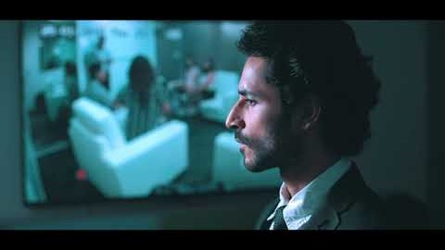
Activity - Experimental Evaluation
UX lab example
Source: https://youtu.be/0Hr-fdfy75Y

Slide 45
Activity - Experimental Evaluation
Briefly recap 2-3 main points on the advantages or capabilities of the UX lab
Are there any negative aspects or potential disadvantages?
Include some related ethical considerations

Slide 46
Heuristic evaluation
5

Slide 47
Heuristic Evaluation
One key method is a self evaluation process for a designer.
Reviewing a design based on a set of rules
Notes:
3-5 inspectors
usability engineers, end users, double experts…
inspect interface in isolation (~1–2 hours for simple interfaces)
compare notes afterwards
single evaluator only catches ~35% of usability problems
5 evaluators catch 75% of problems
Works for paper, prototypes, and working systems

Slide 48
Heuristic Evaluation
Systematic inspection to see if interface complies to guidelines
Method
3-5 inspectors
Works for paper, prototypes, and working systems
usability engineers, end users, double experts…
inspect interface in isolation
compare notes afterwards
single evaluator only catches ~35% of usability problems
5 evaluators catch 75% of problems
Notes:
3-5 inspectors
usability engineers, end users, double experts…
inspect interface in isolation (~1–2 hours for simple interfaces)
compare notes afterwards
single evaluator only catches ~35% of usability problems
5 evaluators catch 75% of problems
Works for paper, prototypes, and working systems

Slide 49
Heuristic Evaluation
Advantages
“minimalist” approach
a few guidelines identify many common usability problems
easily remembered, easily applied with modest effort
discount usability engineering
cheap and fast way to inspect a system
can be done by usability experts, double experts, and end users

Slide 50
Heuristic Evaluation
Problems:
principles are more or less at the motherhood level
can’t be treated as a simple checklist
subtleties involved in their use
Inspect an interface for usability problems with the following 8 principles:
Developed by Saul Greenberg (U. Calgary)

Slide 51
The Heuristic evaluation Process
6

Slide 52
1. Simple and natural dialogue
Use the user’s conceptual model
Match the users’ task sequence
Minimise mapping between interface and task semantics

Slide 53
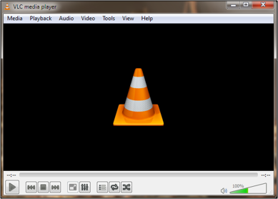
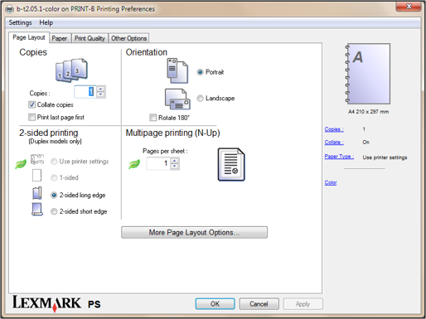
1. Simple and natural dialogue
Present exactly the information the user needs
less is more
information should appear in natural order
related information is graphically clustered
order of accessing information matches user’s expectations
Notes:
Present exactly the information the user needs
less is more
less to learn, to get wrong, to distract...

Slide 54
1. Simple and natural dialogue
Remove or hide irrelevant or rarely needed information
competes with important information on screen
Remove modes
Use windows frugally
don’t add unneeded navigation and window management

Slide 55
Activity - 1. Simple and natural dialogue
See if you can think of an example where you have been confused using a system/app (such as having to look through too much information/content on the screen).
Can you relate to the screenshots shown with similar situations/interactions?

Slide 56
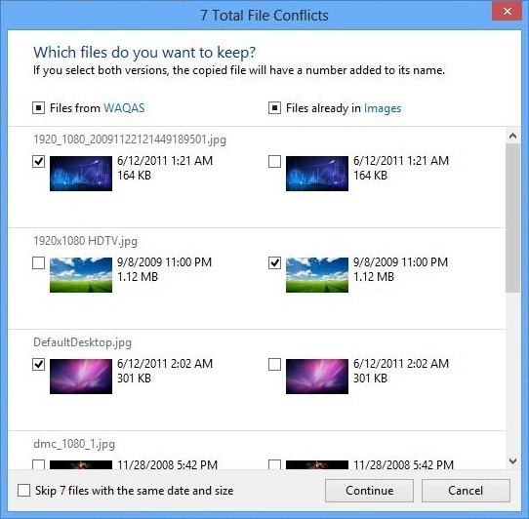
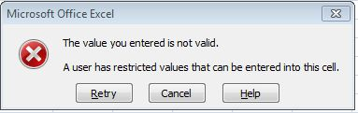
2. Speak the users’ language
Terminology based on users’ language for task
examples: data entry and copying files
http://www.howtoexcelatexcel.com/
http://www.addictivetips.com/windows-tips/windows-8-review/

Slide 57
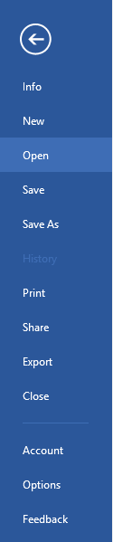
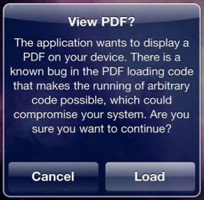
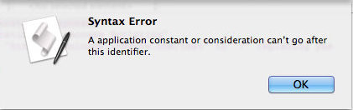
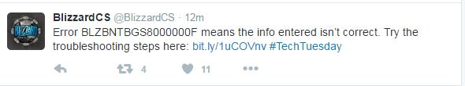
2. Speak the users’ language
http://blog.isthereaproblemhere.com/2011/09/hey-theres-syntax-error-in-your-syntax.html
http://www.mobileapptesting.com/iphone-security-called-into-question-again/2010/08/

Slide 58
Activity - 2. Speak the users’ language
See if you can think of an example where the language used in the app has confused you.
Can you relate to the screenshots shown with similar situations/interactions?

Slide 59
3. Minimise users’ memory load
Computers are good at remembering, people are not!
Promote recognition over recall
menus, icons, choice dialog boxes vs commands, field formats
relies on visibility of objects to the user (but less is more!)

Slide 60
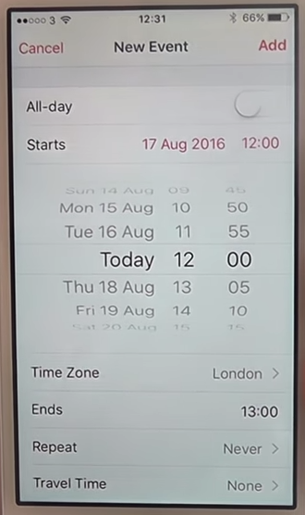
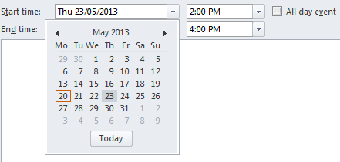
3. Minimise users’ memory load
Example: setting calendar appointments

Slide 61
Activity - 3. Minimise users’ memory load
Think of an example where you have needed to think too much trying to use and interact with a system/app, what was the challenge?
Notes:
3 to 5 minutes

Slide 62
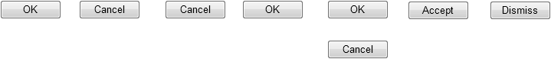
4: Be consistent
Consistent syntax of input
Consist language and graphics
Consistent effects
Notes:
Consist language and graphics
same visual appearance across the system (e.g. widgets)
same information/controls in same location on all windows
Consistent effects
commands, actions have same effect in equivalent situations
predictability

Slide 63
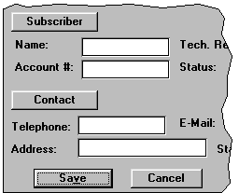
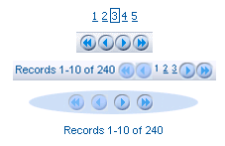
4. Be consistent
These are labels with a raised appearance.
Is it any surprise that people try and click on them?
Keep navigation controls in the same style – don’t mix-and-match.
http://www.uxmatters.com/mt/archives/2009/02/reviewing-user-interfaces.php

Slide 64
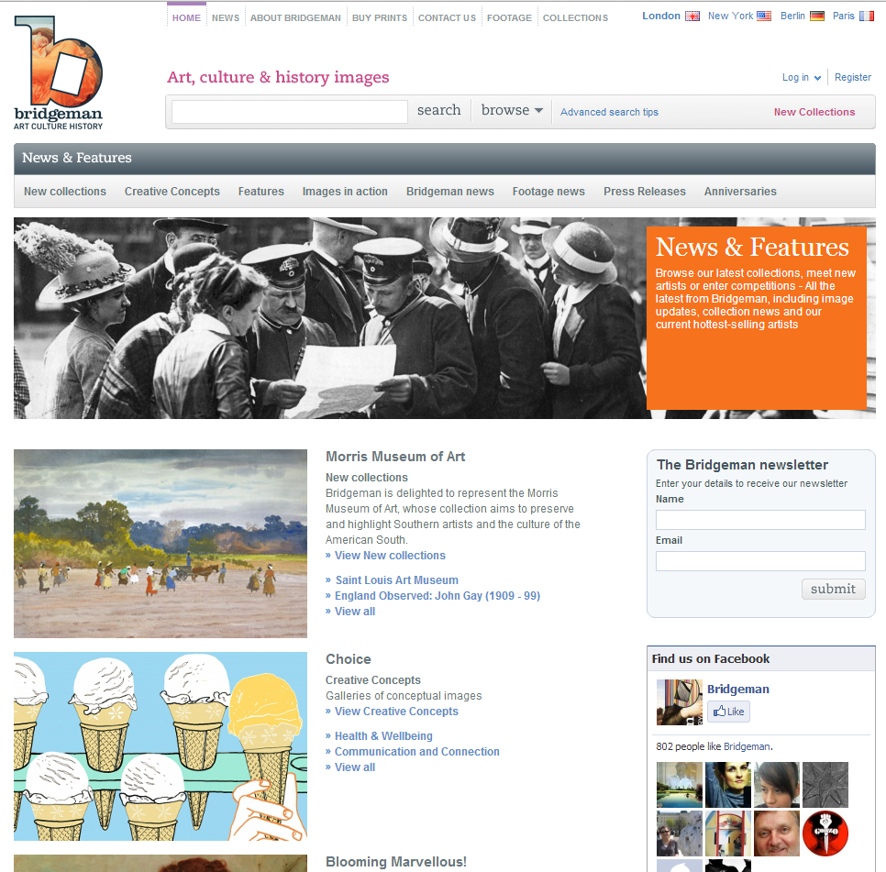
From Bridgeman website

Slide 65

From Bridgeman website

Slide 66
Activity - 4. Be consistent
See if you can think of an example where it is very clear consistency is not being followed in the design.
Can you relate to the screenshots shown with similar situations/interactions?
Are you noticing more systems/apps with a consistent design?

Slide 67

5. Provide feedback
Continuously inform the user about
What’s it doing?
Time for coffee.
> Checking…
> Checking…
This will take 5 minutes...
Notes:
what it is doing
how it is interpreting the user’s input
user should always be aware of what is going on

Slide 68
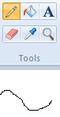
5. Provide feedback
What mode am I in now?
What did I select?
How is the system interpreting my actions?
Microsoft Paint

Slide 69
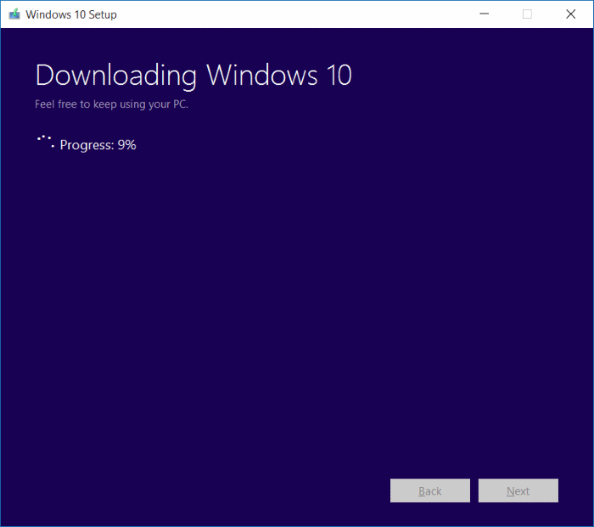
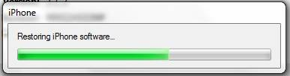
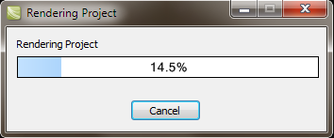
5. Provide feedback
Be as specific as possible, based on user’s input

Slide 70
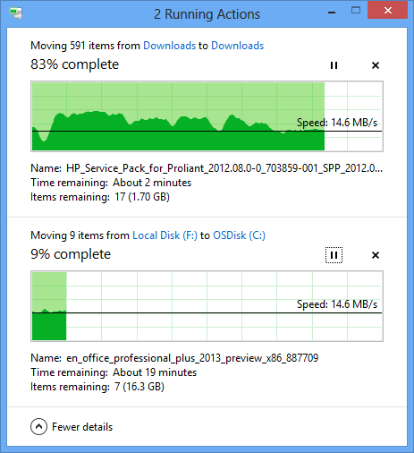
5. Provide feedback
Multiple files being copied, but feedback is file by file.
http://winaero.com/blog/windows-8-1-always-show-more-details-in-copy-dialog-of-file-explorer/

Slide 71
5. Provide feedback
Response time
how users perceive delays
<0.1s perceived as “instantaneous”
1s user’s flow of thought stays uninterrupted, but delay noticed
10s limit for keeping user’s attention focused on the dialog
> 10s user will want to perform other tasks while waiting

Slide 72

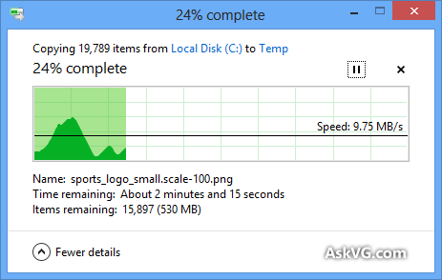
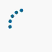

5. Provide feedback
Dealing with long delays
Cursors
for short transactions
Percent done dialogs
time left
estimated time
Random
for unknown times

Slide 73
Activity - 5. Provide feedback
See if you can think of an example where you have been unsure what is happening and you have restarted a task/process or refreshed a webpage.
Can you relate to the screenshots shown with similar situations/interactions?

Slide 74
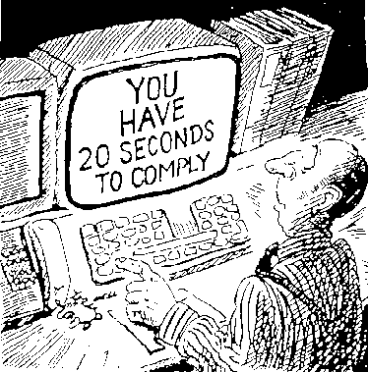
6. Provide clearly marked exits
How do I get out of this?
Notes:
Users don’t like to feel trapped by the computer!
should offer an easy way out of as many situations as possible

Slide 75
6. Provide clearly marked exits
Strategies:
Cancel button (for dialogs waiting for user input)
Universal Undo (can get back to previous state)
Interrupt (especially for lengthy operations)
Quit (for leaving the program at any time)
Defaults (for restoring a property sheet)

Slide 76
Activity - 6. Provide clearly marked exits
Have you ever found yourself ‘lost’ in a system/app?
How did you deal with the situation? Did you get lost again?
Do you think certain user groups are more likely to get ‘lost’?
What are some designs you could implement to help users navigate their way through your system/app?
Can you relate to the screenshots shown with similar situations/interactions?

Slide 77
7. Provide shortcuts
Experienced users - perform frequent operations quickly
Strategies:
keyboard and mouse accelerators
abbreviations
command completion
context menus
function keys
double clicking vs menu selection
type-ahead
navigation jumps
history systems
WWW: ~60% of pages are revisits
Notes:
type-ahead (entering input before the system is ready for it)
navigation jumps
e.g., going to window/location directly, and avoiding intermediate nodes

Slide 78
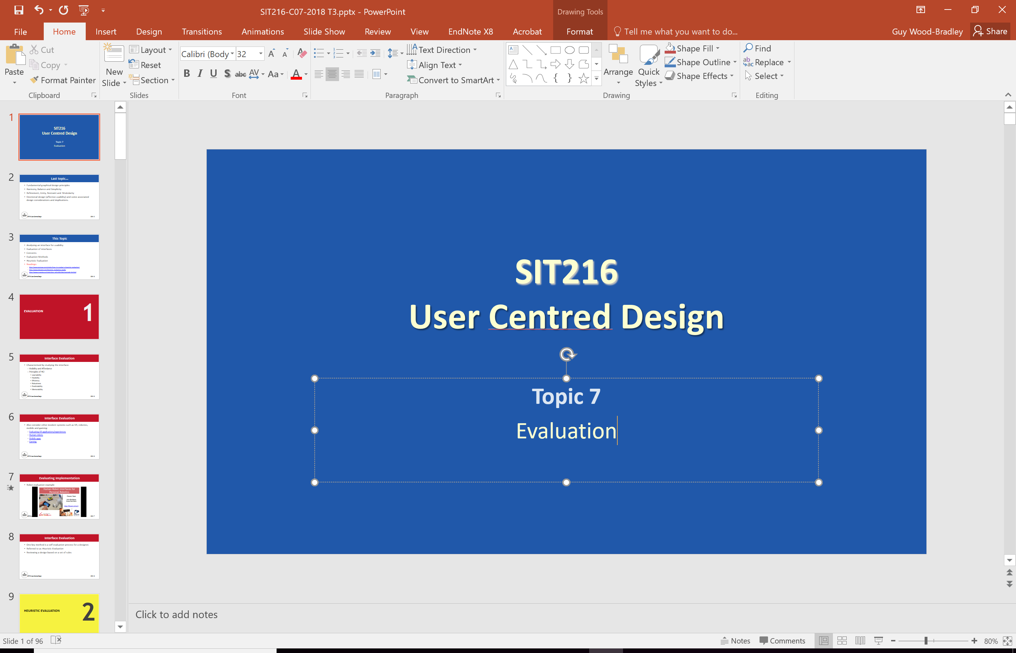
Customisable toolbar for frequent actions
Split menu, with recently used fonts on top
Scrolling controls for page-sized increments

Slide 79
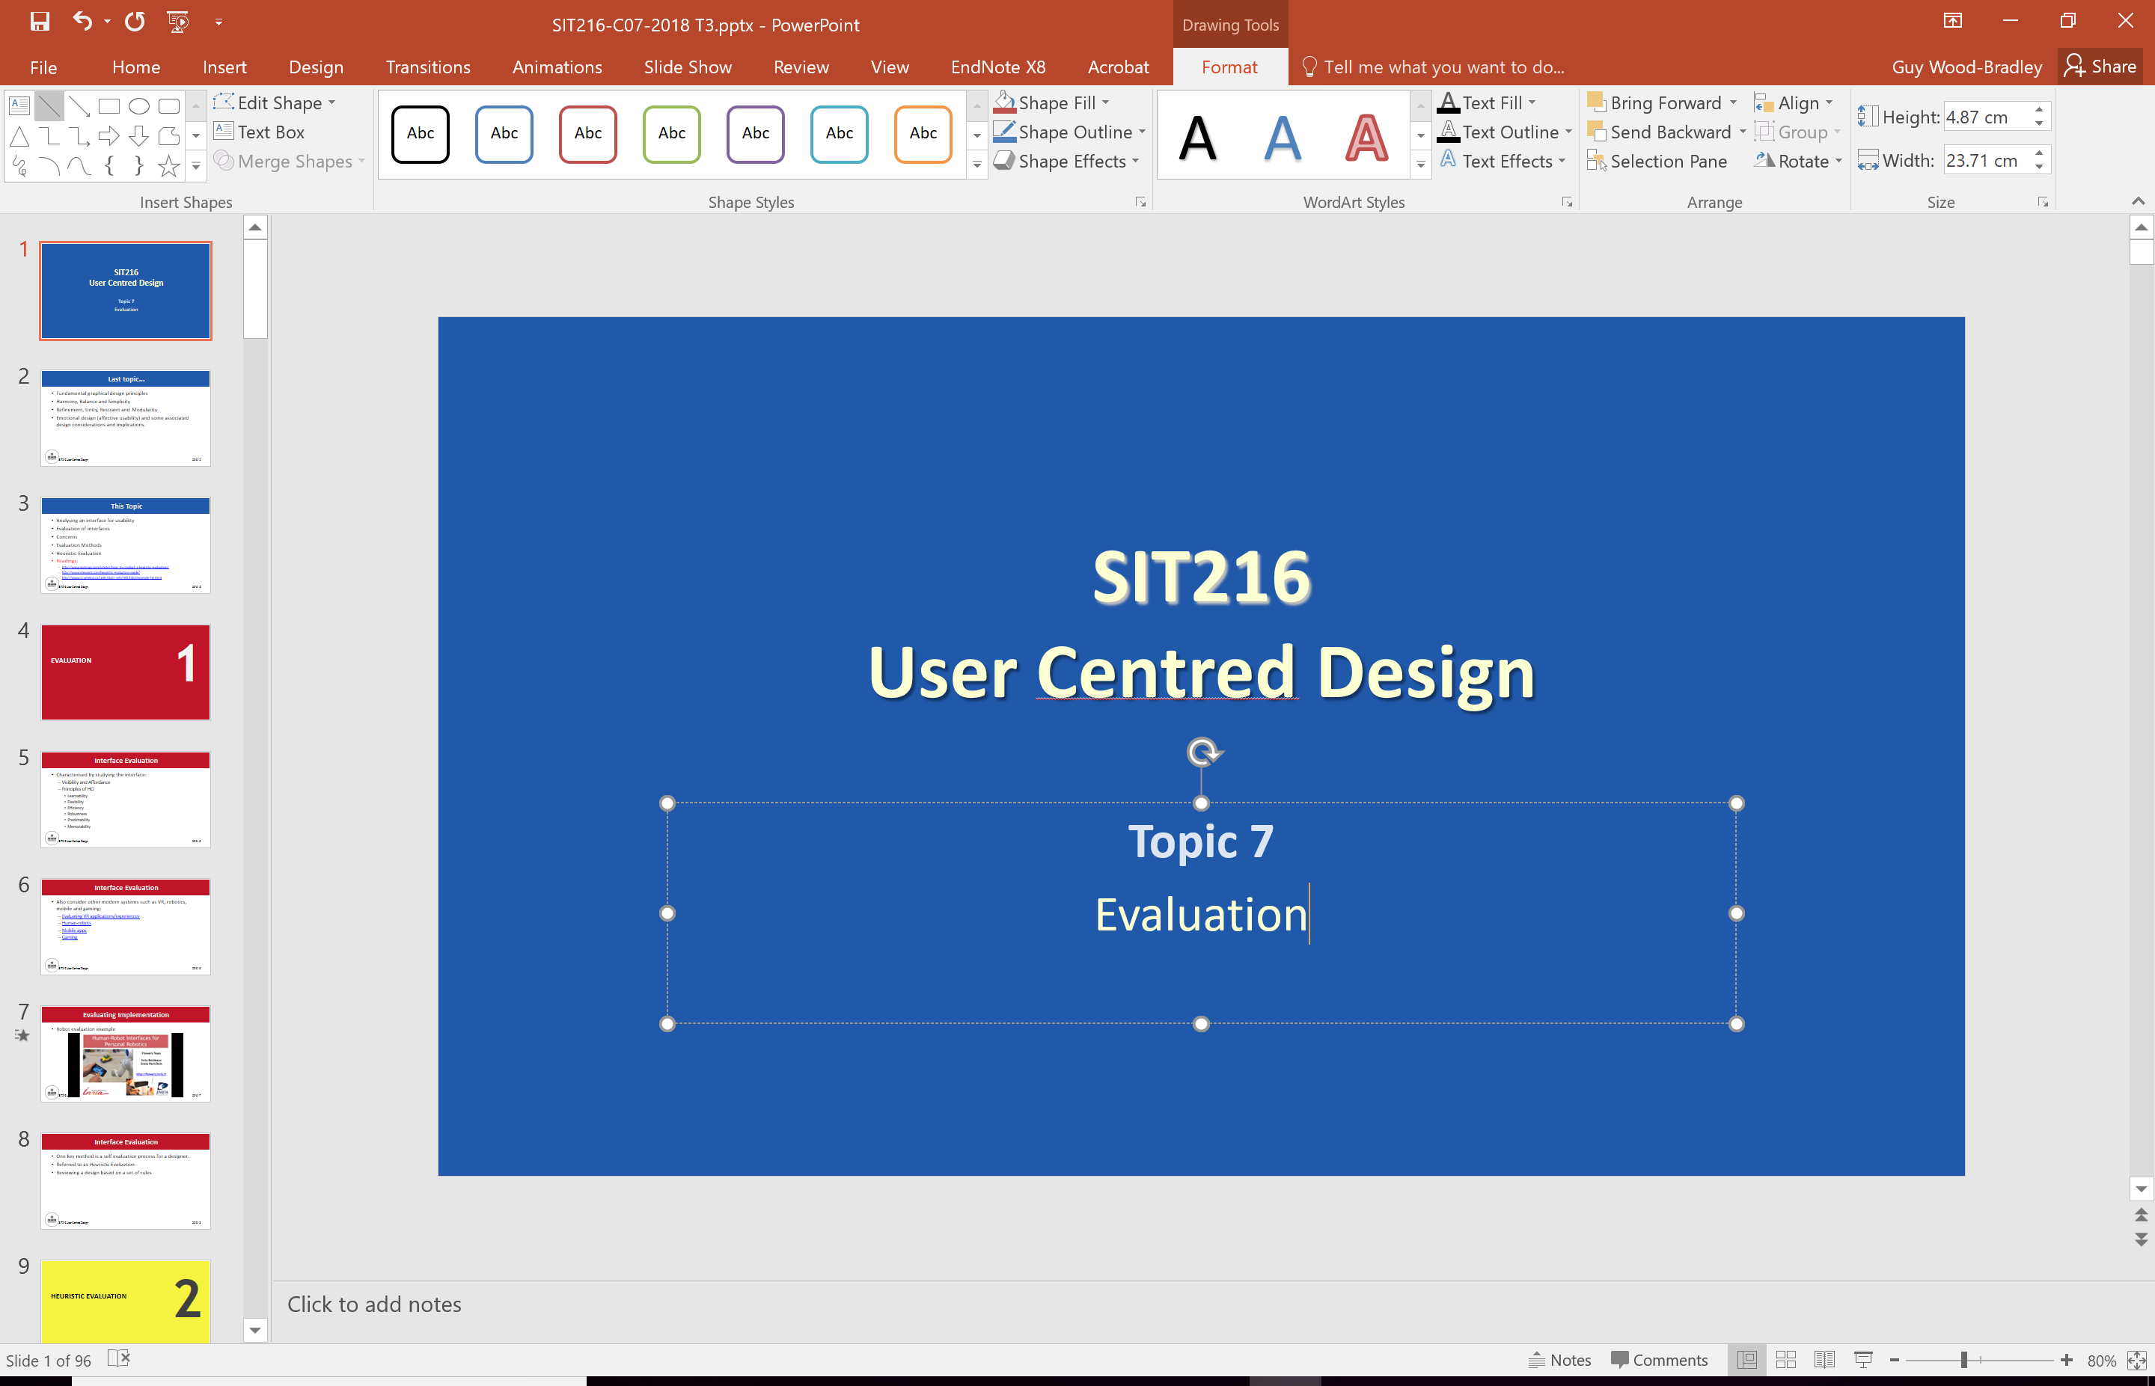
Toolset available appropriate to the selection

Slide 80
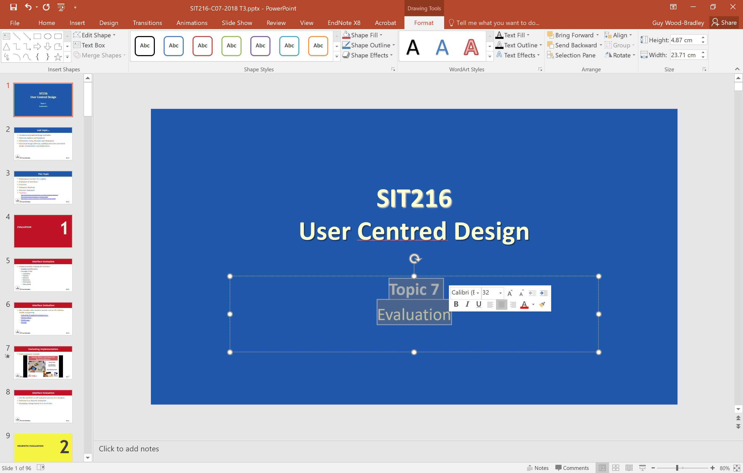
Mini toolbar with appropriate functionality

Slide 81
Activity - 7. Provide shortcuts
What are the common shortcuts you rely on?
Are they mouse/keyboard/gesture shortcuts?
What devices/platforms include shortcuts? For example…?
Can you relate to the screenshots shown with similar situations/interactions?

Slide 82
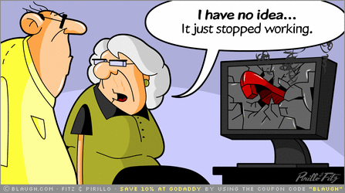
8. Deal with errors positively
People will make errors!
Errors we make
Mistakes
conscious deliberations lead to an error instead of correct solution
Slips
unconscious behaviour gets misdirected en route to satisfying goal
Notes:
Slips
unconscious behaviour gets misdirected en route to satisfying goal
e.g. drive to store, end up in the office
shows up frequently in skilled behaviour
usually due to inattention
often arises from similar actions
General rules
prevent slips before they occur
detect and correct slips when they do occur
user correction through feedback and undo

Slide 83
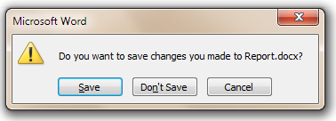
8b. Types of slips
Capture error
frequently done activity takes charge instead of one intended
occurs when common & rarer actions have same initial sequence
Notes:
occurs when common & rarer actions have same initial sequence
change clothes for dinner and find oneself in bed (William James, 1890)
confirm saving of a file when you don’t want to delete it
Capture error
minimise by
make actions undoable instead of confirmation
allows reconsideration of action by user
e.g. open trash to undelete a file

Slide 84
8b. Types of slips
Description error
intended action similar to others that are possible
usually occurs when right & wrong objects physically near each other
minimise by
rich feedback
check for reasonable input, etc.
undo
Notes:
intended action similar to others that are possible
usually occurs when right & wrong objects physically near each other
pour juice into bowl instead of glass
throw sweaty shirt in toilet instead of laundry basket
move file to wrong folder with similar name
minimise by
rich feedback
check for reasonable input, etc.
undo

Slide 85
8b. Types of slips
Loss of activation
forget what the goal is while undergoing the sequence of actions
minimise by
if system knows goal, make it explicit
if not, allow person to see path taken
Notes:
forget what the goal is while undergoing the sequence of actions
start going to room and forget why you are going there
navigating menus/dialogs and can’t remember what you are looking for
but continue action to remember (or go back to beginning)!

Slide 86
8b. Types of slips
Mode errors
people do actions in one mode thinking they are in another
minimise by
have as few modes as possible (preferably none)
make modes highly visible
Notes:
people do actions in one mode thinking they are in another
refer to file that’s in a different directory
look for commands / menu options that are not relevant

Slide 87
8c. Generic responses for errors
General idea: forcing functions
prevent / mitigate continuation of wrongful action
Gag (stop)
deals with errors by preventing the user from continuing
For example, cannot get past login screen until correct password entered

Slide 88
8c. Generic responses for errors
Warn
warn people that an unusual situation is occurring
when overused, becomes an irritant
Notes:
e.g.,
audible bell
alert box

Slide 89
8c. Generic responses for errors
Do nothing
illegal action just doesn’t do anything
user must infer what happened
Self-correct
system guesses legal action and does it instead
but leads to a problem of trust
spelling corrector
Notes:
Do nothing
illegal action just doesn’t do anything
user must infer what happened
enter letter into a numeric-only field (key clicks ignored)
put a file icon on top of another file icon (returns it to original position)

Slide 90
8c. Generic responses for errors
Let’s talk about it
system initiates dialog with user to come up with solution to the problem
Teach me
system asks user what the action was supposed to have meant
action then becomes a legal one
Notes:
system initiates dialog with user to come up with solution to the problem
compile error brings up offending line in source code

Slide 91
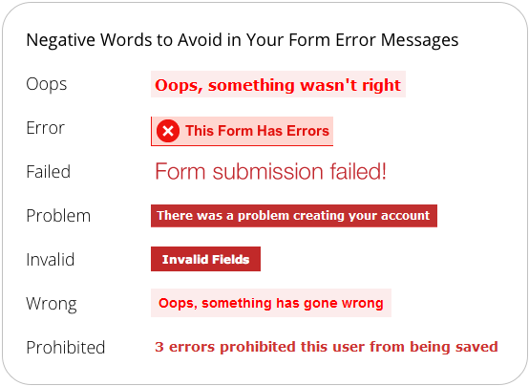
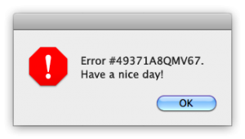
8. Deal with errors positively

Slide 92
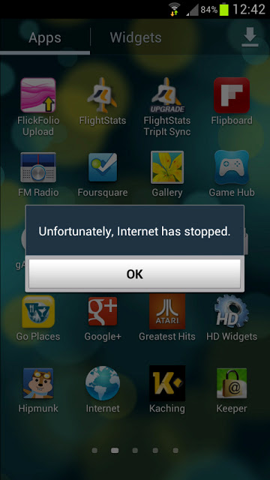
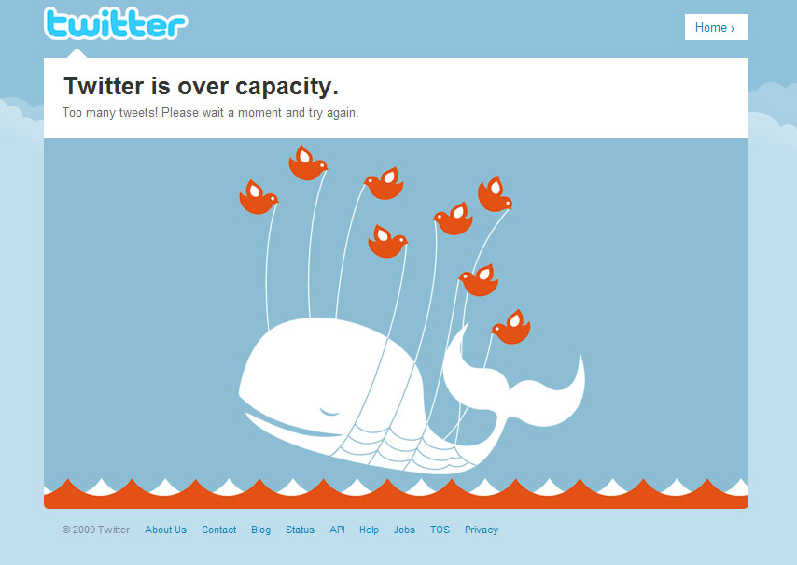
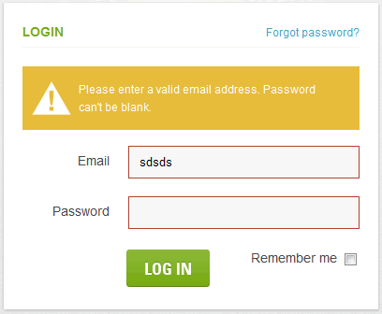
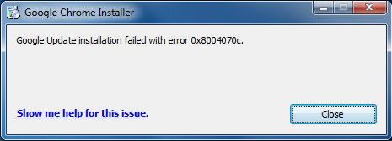
8. Deal with errors positively
http://www.lattimore.id.au/2010/01/20/twitter-is-over-capacity/
http://blog.isthereaproblemhere.com/2012/07/most-frightening-error-message.html
http://blog.isthereaproblemhere.com/2011/08/sorry-you-may-not-install-other.html
http://www.smileycat.com/design_elements/error_messages/

Slide 93
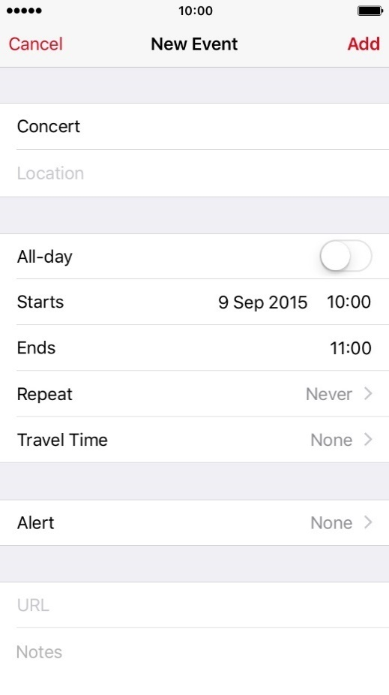
8. Deal with errors positively
Provide meaningful error messages
error messages should be in the user’s task language
don’t make people feel stupid
Prevent errors
try to make errors impossible
modern widgets: can only enter legal data

Slide 94
8. Deal with errors positively
Provide reasonableness checks on input data
on entering order for office supplies
5000 pencils is an unusually large order. Do you really want to order that many?

Slide 95
Activity - 8. Deal with errors positively
Can you recall any errors/error messages you have encountered that confused you?
How do you deal with a system/app that has given you an error?
Are there any well designed errors you would like to see considered in other systems/apps?
Why do we see ‘complicated’ errors?

Slide 96
some thoughts
6

Slide 97
Some Thoughts…
Detection of problems before launch
Ensures quality product hits the market and therefore maintains your reputation
Feedback - helps the team understand what the user really wants to do
Uncovers assumptions about users that limit design and implementation

Slide 98
Some Thoughts…
If you want a great product, you’ve got to test
you are too close to the product
testing gives you a fresh perspective
Testing one user is 100% better than testing none
The worst tester with the wrong user will still show you things that will improve your product

Slide 99
Some Thoughts…
Testing one user early in the project is better than testing 50 near the end – a simple test early, while you still have time to use what you learn from it
The importance of recruiting “representative” users is overrated – yes it is important to test the intended audience BUT it’s much more important to test early and often

Slide 100
Some Thoughts…
The point of testing is not to prove or disprove something …..its to inform your judgement
Testing is an iterative process – testing isn’t something you do once. You make something, test it, fix it and test it again
Nothing beats a live audience reaction

Slide 101

Summary
Which approach?
Source: https://youtu.be/OtUWbsvCujM

Slide 102
Summary
If you want a great product, you’ve got to test
you are too close to the product
testing gives you a fresh perspective
Testing one user is 100% better than testing none
The worst tester with the wrong user will still show you things that will improve your product
Notes:
Testing one user early in the project is better than testing 50 near the end – a simple test early, while you still have time to use what you learn from it
The importance of recruiting “representative” users is overrated – yes it is important to test the intended audience BUT it’s much more important to test early and often

Slide 103
Summary
Heuristic Evaluation: Detection of problems before launch
Ensures quality product hits the market and therefore maintains your reputation
Feedback - helps the team understand what the user really wants to do
Uncovers assumptions about users that limit design and implementation
Notes:
The point of testing is not to prove or disprove something …..its to inform your judgement
Testing is an iterative process – testing isn’t something you do once. You make something, test it, fix it and test it again
Nothing beats a live audience reaction

Slide 104
Summary
Evaluation is central to UCD – solutions must be designed based on human (user) needs and requirements that achieve their intended goals
Many evaluation methods exist and can be used to help validate the findings from the activities required for UCD
Evaluation needs to be conducted in an ethical manner and data collected, used and published stored and published appropriately
The nature and structure of experiments should vary depending on their purpose
Evaluation better informs the designer/design team to improve upon the design and increase the likelihood of user acceptance.

